Slide 1
Module 4

Slide 2
Content based image retrieval
Standardized systems that make use of image features to retrieve images from databases or from the web.
The types of features typically used are such statistical measures as the color histogram for an image.
Other simple features used are such descriptors as color layout, meaning a simple sketch of where in a checkerboard grid covering the image to look for blue skies and orange sunsets.
Another feature used is texture, meaning some type of descriptor typically based on an edge image, formed by taking partial derivatives of the image itself — classifying edges according to closeness of spacing and orientation.

Slide 3
C-BIRD — A Case Study
This system is called Content-Based Image Retrieval from Digital libraries (C-BIRD)

Slide 4
Color Histogram
In C-BIRD, features are precomputed for each image in the database.
The most prevalent feature that is utilized in image database retrieval is the color histogram .
A type of global image feature, that is, the image is not segmented; instead, every image region is treated equally.
A color histogram counts pixels with a given pixel value in red, green, and blue (RGB).

Slide 5
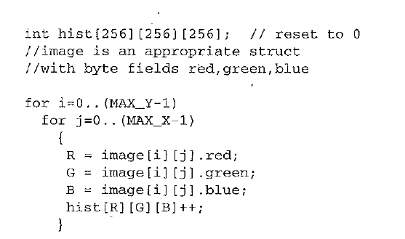
Algorithm

Slide 6
Contd…
C-BIRD calculates a color histogram for each target image as a preprocessing step, then references it in the database for each user query image.
The histogram is defined coarsely, with bins quantized to 8 bits, with 3 bits for each of red and green and 2 for blue.
The standard measure used for color histograms is called the histogram intersection.
First, a color histogram Hi is generated for each image i in the database.

Slide 7

Now suppose we select a "model" image — the new image to match against all possible targets in the database.
Its histogram Hm is intersected with all database image histograms Hi. where superscript j denotes histogram bin j, with each histogram having n bins.

Slide 8
Color Density
The user selects the percentage of the image having any particular color or set of colors, using a color picker and sliders.
We can choose from either conjunction (ANDing) or disjunction (ORing) a simple color percentage specification.

Slide 9
Color Layout
The user can set up a scheme of how colors should appear in the image, in terms of coarse blocks of color.
The user has a choice of four grid sizes: 1 x 1,2x2,4x4 and 8 x 8.
Search is specified on one of the grid sizes, and the grid can be filled with any RGB color value — or no color value at all, to indicate that the cell should not be considered

Slide 10
Texture Layout
Similar to color layout search, this query allows the user to draw the desired texture distribution.
Available textures are zero density texture, medium-density edges in four directions (0°, 45°, 90°, 135°) and combinations of them, and high-density texture in four directions and combinations of them.
Texture matching is done by classifying textures according to directionality and density (or separation) and evaluating their correspondence to the texture distribution selected by the user in the texture block layout.

Slide 11
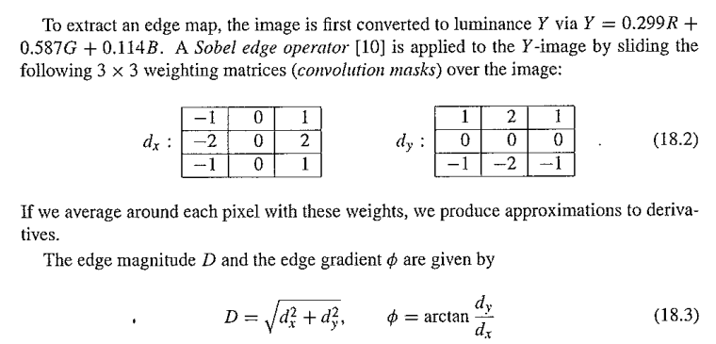
Texture Analysis Details

Slide 12
Search by illumination Invariance
Illumination change can dramatically alter the color measured by camera RGB sensors, from pink under daylight to purple under fluorescent lighting, for example.
To deal with illumination change from the query image to different database images, each color-channel band of each image is first normalized, then compressed to a 36-vector .
Normalizing each of the R, G, and B bands of an image serves as a simple yet effective guard against color changes when the lighting color changes.

Slide 13
A two-dimensional color histogram is then created using the chromaticity
A 128 x 128-bin 2D color histogram can then be treated as an image and compressed using a wavelet-based compression scheme .
To further reduce the number of vector components in a feature vector, the DCT coefficients for the smaller histogram are calculated and placed in zigzag order, then all but 36 components are dropped.

Slide 14
Search by Object Model
The user picks a sample image and interactively selects a region for object searching. Objects photographed under different scene conditions are stil! effectively matched. This search type proceeds by the user selecting a thumbnail and clicking the Model tab to enter Object

Slide 15
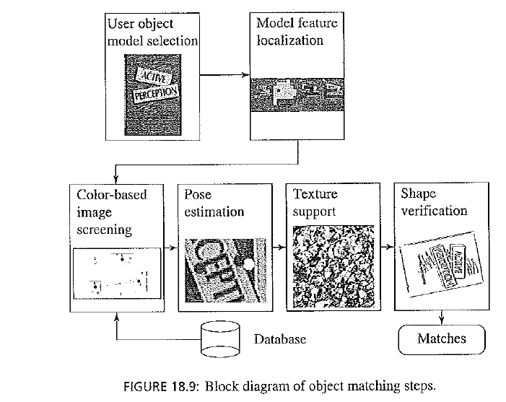

Slide 16
User object model selection
An image region can be selected using primitive shapes such as a rectangle or ellipse, a magic wand tool that is basically a seed-based flooding algorithm, an active contour (a "snake"), or a brush tool, where the painted region is selected.
Once the object region is defined to a user's satisfaction, it can be dragged to the right pane, showing all current selections. Multiple regions can be dragged to the selection pane, but only the active object in the selection pane will be searched on.

Slide 17
Locales in Feature Localization
The Search by Object Model introduced above finding an object inside a target image — is a desirable yet difficult mechanism for querying multimedia data.
An added difficulty is that objects can be photographed under different lighting conditions
A set of rough, possibly overlapping regions (called locales ) to express not a complete image segmentation but instead a coarser feature localization.
Tile is the building unit for feature localization. Tiles group pixels with similar features within their extent

Slide 18
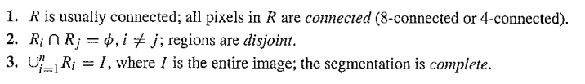
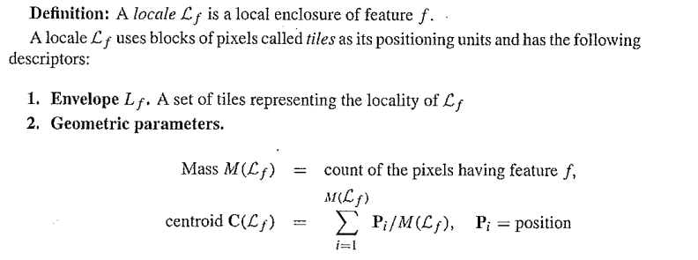
Feature Localization versus Image Segmentation
Image Segmentation
Feature Localization
3 .Color, texture, and shape parameters of the locale

Slide 19
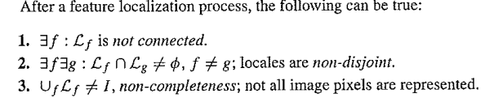

Slide 20

Tile Classification
Before locales can be generated, tiles are first classified as having certain features, for example, red tiles, or red and blue tiles.
Dominant Color Enhancement
To localize on color, we first remove noise and blurring by restoring colors smoothed out during image acquisition.
The image is converted from the RGB color space to a chromaticity-luminance color space. For a pixel with color (R, G, B), we define

Slide 21
Prior to classifying feature tiles, image pixels are classified as having either dominant color or transitional color.
Pixels are classified dominant or transitional by examining their neighborhood.
Definition: Dominant colors are pixel colors that do not lie on a slope of color change in their pixel neighborhood. Transitional colors do.

Slide 22
Tile feature list
Tiles have a tile feature list of all the color features associated with the tile and their geomet­rical statistics.
On the first pass, dominant pixels are added to the tile feature list. For each pixel added, if the color is close to a feature on the list within the luminance-chromaticity thresholds, the color and geometrical statistics for the feature are updated. Otherwise, a new color feature is added to the list. This feature list is referred to as the dominant feature list.
On the second pass, all transitional colors are added to the dominant feature list without modifying the color, but updating the geometrical statistics. To determine which dominant feature list node the transitional pixel should merge to, we examine the neighborhood of the transitional pixel and find the closest color that is well represented in the neighborhood

Slide 23
Locale Generation
Locales are generated using a dynamic 4x4 overlapped pyramid linking procedure .
On each level, parent nodes compete for inclusion of child nodes in a fair competition.
Image tiles are the bottom-level child nodes of the pyramid, and locales are generated for the entire image when the competition propagates to the top level.
The top-level pyramid node has a list of color features with associated envelopes (collections of tiles) and geometrical statistics

Slide 24
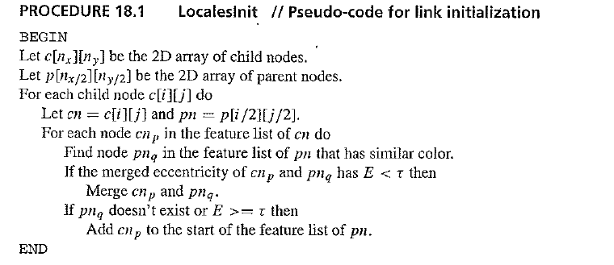

Slide 25
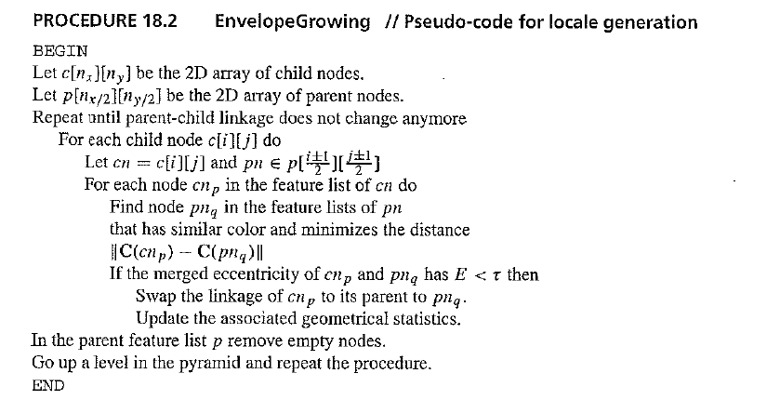

Slide 26
Texture Analysis
Every locale is associated with a locale-based texture histogram
Thus a locale-dependent threshold makes more sense in generating the edge map.
The threshold is obtained by examining the histogram of the locale edge magnitudes. The texture histogram is smoothed using a Gaussian filter and subsampled to size 8x7, then normalized.
The locale-based texture is a more effective measure of texture than is a global one, since the locale-dependent thresholds can be adjusted adaptively.

Slide 27
some edge points are missing when using global thresholding, but most of them exist when using locale-based thresholding.
To draw the locale-based edge-map, edge pixels generated for any locale are unioned together.

Slide 28
Object Modeling and Matching
Object models in C-BIRD consist of a set of localized features.
They provide a rich set of statistical measures for later matching.
Moreover, their geometric relationships, such as the spatial arrangement of locales, are also extracted.
They are best represented using vectors connecting centroids of the respective locales.

Slide 29
The object image selected by the user is sent to the server for matching against the locales database.
The localization of the submitted model object is considered the appropriate localization for the object, so that image locales need to be found that have a one-to-one correspondence with model locales. Such a correspondence is called an assignment.

Slide 30
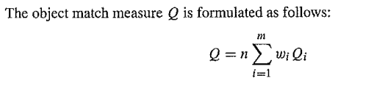
A locale assignment has to pass several screening tests to verify an object match.
where n is the number of locales in the assignment, m is the number of screening tests considered for the measure, Qi is the fitness value of the assignment in screening test , and wi are weights that correspond to the importance of the fitness value of each screening test. Care has to be taken to normalize the Qi values to lie in the range [0.. 1]

Slide 31
Locales with higher mass (more pixels) statistically have a smaller percentage of local­ization error.
We try to assign as many locales as possible first, then compute the match measure and check the error using a tight threshold.
Locales are removed or changed in the assignment as necessary until a match is obtained. At that point, it is probably the best match measure possible, so it is unnecessary to try other assignments. In this case, all possible permutations of locale assignments do not have to checked.
In the worst case, when the object model is not present in the search image, we have to test all assignments to determine there is no match.

Slide 32
Matching Steps
The screening tests applied to locales to generate assignments and validate them are: •
Color-based screening test
Illumination color covariant screening
Chromaticity voting
Elastic correlation
Estimation of image object pose
Texture support
Shape verification
Recovery of lighting changes

Slide 33
The idea of color covariant matching is to realize that colors may change, from model to target, since the lighting may easily change. A diagonal model of lighting change states that the entire red channel responds to lighting change via an overall multiplicative change,
Using the chromaticity voting scheme, all image locales are paired with all model locales to vote for lighting change values in a voting array.
We can evaluate the feasibility of having an assignment of image locales to model locales using the estimated chromaticity shift parameters by a type of elastic correlation

Slide 34
The texture-support screening test uses a variation of histogram intersection technique, where the texture histograms of locales in the assignment are intersected. If the intersection measure is higher than a threshold, the texture match is accepted.
The final match verification process is shape verification by the method of Generalized Hough Transfonn (GHT) . The GHT is robust with respect to noise and occlusion . Performing a full GHT search for all possible rotation, scale, and translation parameters is computationally expensive and inaccurate.

Slide 35
However, after performing pose estimation, we already know the pose parameters and can apply them to the model reference point to find the estimated reference point in the database image.

Slide 36
Video Locales
Definition: A video locale is a sequence of image feature locales that share similar features in the spatiotemporal domain of videos.
Like locales in images, video locales have their color, texture, and geometric properties. Moreover, they capture motion parameters, such as motion trajectory and speed, as well as temporal information, such as the lifespan of the video locale and its temporal relationships with respect to other video locales.

Slide 37
CURRENT IMAGE SEARCH SYSTEMS
QBIC
Query by Image Content
One interesting feature in QBIC is the metric it uses for color histogram difference.
Instead of simple histogram intersection, the metric recognizes that colors that are similar, such as red and orange, should not have a zero intersection.
Instead, a color-distance matrix A is introduced, with elements

Slide 38
UC Santa Barbara Search Engines
Alexandria Digital Library (ADL) is a seasoned image search engine devised at the University of California, Santa Barbara. The ADL is presently concerned with geographical data: "spatial data on the web".
Multiresolution images means that it is possible to select a certain region within an image and zoom in on it.

Slide 39
NETRA -is also part of the Alexandria Digital Library project. Now in its second generation as NETRA II, it emphasizes color image segmentation for object­or region- based search.
Perception-Based Image Retrieval (PBIR) aims at a better version of learning and relevance feedback techniques with learning algorithms that try to get at the underlying query behind the user's choices in zeroing in on the right target.

Slide 40
Berkeley Digital Library Project
Text queries are supported, with search aimed at a particular commercial or other set of stock photos.
Chabot
Chabot uses the relational database management system POST-GRES to access these images and associated textual data. The system stores both text and color histogram data.

Slide 41
Blobworld It attempts to capture the idea of objects by segmenting images into regions.
Blobworld allows for both textual and content-based searching.

Slide 42
Columbia University Image Seekers
It uses content-based image retrieval based on color, texture, and color composition.
VisualSEEk is a color-photograph retrieval system. Queries are by color layout, or by an image instance, such as the URL of a seed image, or by instances of prior matches.
SaFe, an integrated spatial and feature image system, extracts regions from an image and compares the spatial arrangements of regions

Slide 43
WebSEEk collects images (and text) from the web.
Informedia -video mining
MetaSEEk
The idea is to query several other online image search engines, rank their performance for different classes of visual queries, and use them selectively for any particular search.

Slide 44
Photobook and FourEyes
It searches for three different types of image content (faces, 2-D shapes, and texture images) using three mechanisms
MARS (Multimedia Analysis and Retrieval System)
The idea was to create a dynamic system of feature representations that could adapt to different applications and different users. ARS (Multimedia Analysis and Retrieval System)

Slide 45
Visual Information Retrieval (Virage) operates on objects within images. Image indexing is performed after several preprocessing operations, such as smoothing and contrast enhancement.
Visual RetrievalWare is an image search technology owned by Convera, Inc. It is built on techniques created for use by various government agencies for searching databases of standards documents.

Slide 46
Relevance feedback -images retrieved are used in further rounds of convergence onto correct returns.
eg :iFind

Slide 47
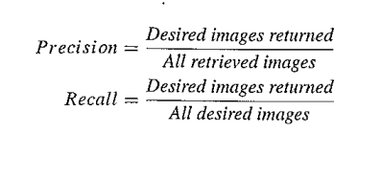
QUANTIFYING RESULTS
Precision is the percentage of relevant documents retrieved compared to the number of all the documents retrieved.
Recall is the percentage of relevant documents retrieved out of all relevant documents.

Slide 48
Recall and precision are widely used for reporting retrieval performance for image retrieval systems as well.
However, these measures are affected by the database size and the amount of similar information in the database.
Also, they do not consider fuzzy matching or search result ordering.
The curve of precision versus recall is termed a receiver operator characteristic (ROC) curve.
It plots the relationship between sensitivity and specificity over a range of parameters.

Slide 49
QUERYING ON VIDEOS
Video indexing can make use of motion as the salient feature of temporally changing images for various types of queries.
Temporality is the main difference between a video and just a collection of images, dealing with the time component is first and foremost in comprehending the indexing, browsing, search, and retrieval of video content.
The first place to start, then, would be dividing the video into shots, where each shot consists roughly of the video frames between the on and off clicks of the Record button.
However, transitions are often placed between shots — fade-in, fade-out, dissolve, wipe, and so on — so detection of shot boundaries may not be so simple as for abrupt changes.

Slide 50
A simple approach to this idea is to uncompress just enough to recover the DC term,
Once DC frames are obtained from the whole video — or, even better, are obtained on the fly — many approaches have been used for finding shot boundaries.
Features used have typically been color, texture, and motion vectors, although such concepts as trajectories traversed by objects have also been used

Slide 51
Shots are grouped into scenes.
A scene is a collection of shots that belong together and that are contiguous in time.
Even higher-level semantics exist in so-called "film grammar" .
Semantic information such as the basic elements of the story may be obtainable. These are (at the coarsest level) the story's exposition, crisis, climax, and denouement.

Slide 52
Audio information is important for scene grouping. In a typical scene, the audio has no break within a scene, even though many shots may take place over the course of the scene.
General timing information from movie creation may also be brought to bear.
Text may indeed be the most useful means of delineating shots and scenes, making use of closed-captioning information already available. However, relying on text is unreliable, since it may not exist, especially for legacy video.

Slide 53
Different schemes have been proposed for organizing and displaying storyboards rea­sonably succinctly. The most straightforward method is to display a two-dimensional array of keyframes.
One approach might be to simply output one frame every few seconds. However, action has a tendency to occur between longer periods of inactive story. Therefore, some kind of clustering method is usually used, to represent a longer period of time that is more or less the same within the temporal period belonging to a single keyframe.

Slide 54
graph-based method.
Suppose we have a video of two talking heads, the interviewer and the interviewee.
A sensible representation might be a digraph with directed arcs taking us from one person to the other, then back again.
In this way, we can encapsulate much information about the video's structure and also have available the arsenal of tools developed for graph pruning and management.

Slide 55
Other "proxies" have also been developed for representing shots and scenes. A grouping of sets of keyframes may be more representative than just a sequence of keyframes, as may keyframes of variable sizes. Annotation by text or voice, of each set of keyframes in a "skimmed" video, may be required for sensible understanding of the underlying video.
A mosaic of several frames may be useful, wherein frames are combined into larger ones by matching features over a set of frames. This results in set of larger keyframes that are perhaps more representational of the video.

Slide 56
An even more radical approach to video representation involves selecting (or creating) a single frame that best represents the entire movie!.
This could be based on making sure that people are in the frame, that there is action, and so on.

Slide 57
By taking into account skin color and faces, the algorithm increases the likelihood of the selected keyframe including people and portraits, such as close-ups of movie actors, thereby producing interesting keyframes.
Skin color is learned using labeled image samples. Face detection is performed using a neural net.

Slide 58
Other approaches attempt to deal with more profoundly human aspects of video, as opposed to lower-level visual or audio features.
Much effort has gone into applying data mining or knowledge-base techniques to classifying videos into such categories as sports, news, and so on, and then subcategories such as football and basketball.

Slide 59
QUERYING ON OTHER FORMATS
Work on using audio or combining audio with video to better comprehend multimedia content is fascinating.
Other features researchers have looked at for indexing include indexing actions, concepts and feelings, facial expressions, and so on.
Clearly, this field is a developing and growing one, particularly because of the advent of the MPEG-7 standard

Slide 60
OUTLOOK FOR CONTENT-BASED RETRIEVAL
content-based retrieval identified the following present and future trends: indexing, search, query, and retrieval of multimedia data based on
1. Video retrieval using video features: image color and object shape, video segmenta­tion, video keyframes, scene analysis, structure of objects, motion vectors, optical flow (from computer vision), multispectral data, and so-called "signatures" that summarize the data

Slide 61
Spatiotemporal queries, such as trajectories
Semantic features; syntactic descriptors
Relevance feedback, a well-known technique from information retrieval
Sound, especially spoken documents, such as using speaker information
Multimedia database techniques, such as using relational databases of images
Fusion of textual, visual, and speech cues
Automatic and instant video manipulation; user-enabled editing of multimedia databases
Multimedia security, hiding, and authentication techniques such as watermarking

